Slide 1
Test Driven Development
Comp2151- Agile Software Development
Lecture 5

Slide 2
Test-driven development (TDD)
A software development technique used commonly by agile developers in which the test (that fails) is written before the functional code.
In contrast to the traditional (and linear ) approach where testing is done after writing the functional code.
XP(extreme programming) introduced the concept of test-first programming in 1999.

Slide 3
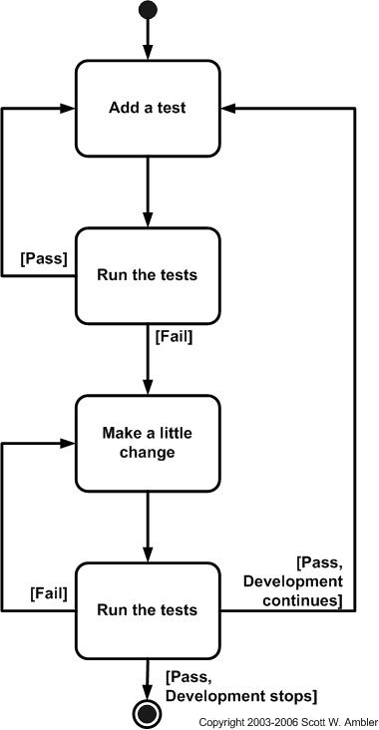
TDD Sequence of Steps
Scott Ambler created this flowchart (Activity Diagram) for the TDD process
Add a test
Run tests (and see if the new one fails)
Write some code (to make the failed test pass)
Run tests
Refactor code
Repeat

Slide 4
TDD Sequence of Steps
Add a test
Development of every new software feature starts by writing the test case first. The developer uses requirements specifications (use cases, user stories to write the test that will check the functional code of the feature for normal and exceptional scenarios.
It’s a good requirement elicitation technique because the developer focusses more on the requirements while writing the test cases as opposed to the traditional approach in which tests are written afterwards

Slide 5
TDD Sequence of Steps
2. Run tests (and see if the new one fails)
The new(er) test would always fail as the code (that it tests) is not there yet so after its failure developer will add the code to make sure that this test passes.

Slide 6
TDD Sequence of Steps
3. Write some code (to make the failed test pass)
Just write enough code to make the failed test pass and do not write code beyond the functionality that the test under question checks
The new code written at this stage is not perfect or comprehensive and should only provide sufficient functionality to ensure passing of the test.
The code will be refactored later to provide improved functionality in step-5.

Slide 7
TDD Sequence of Steps
4. Run all tests
Run all the tests again to make sure they pass and the code meets tests’ requirement and If they do not pass keep enhancing the code.

Slide 8
TDD Sequence of Steps
5. Refactor code
Clean up the code.
Remove any duplications and redundancies in the code.
Add extra functionality and re organize modules, classes, methods etc to ensure code readability and maintainability.

Slide 9
TDD Sequence of Steps
6. Repeat
Add a new test and repeat the process.

Slide 10
The Three Laws of TDD
You must write a failing test before you write any production code.
You must not write more of a test than is sufficient to fail, or fail to compile.
You must not write more production code than is sufficient to make the currently failing test pass.

Slide 11
Red, Green, Refactor
A TDD framework based on the three laws of TDD that developers use to build a test suite, write implementation code, and optimize their codebase in short development cycles.
Red — think about what you want to develop
Green — think about how to make your tests pass
Refactor — think about how to improve your existing implementation

Slide 12
Red-Green-Refactor cycle
Create a test to introduce a change. Run the test and if it passes (green) then it means change was redundant as the existing software was sufficient in functionality
However If it fails (red) it means change has not been implemented yet so implement the change and run the test again. If the change has been implemented successfully then the test will pass (green).
Refactor the code to improve design, performance, or other qualities that may have been impacted by the change. Re-run the if this refactoring has not affected the desired behavior, then the test will still pass.
Previously written tests should also be run before any change is committed, as other tested code may have been compromised by the modification.
Make it work
Eliminate redundancy and repetition
Create test that fails

Slide 13
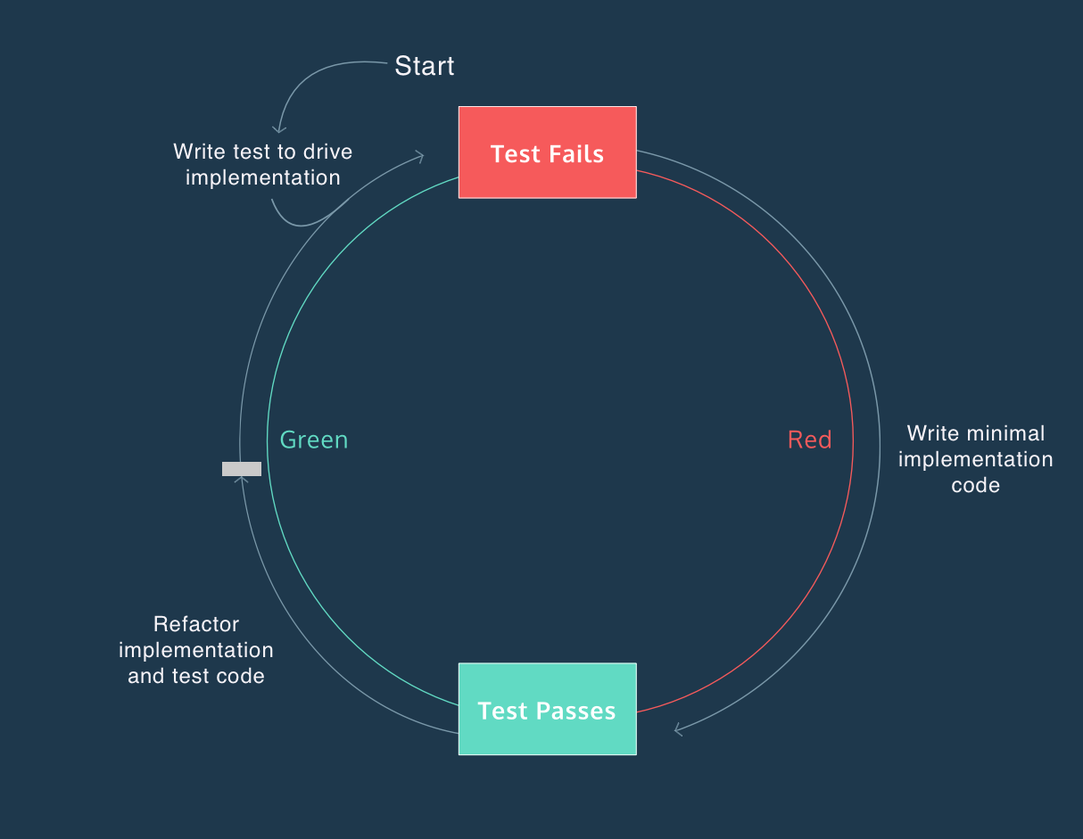
Red-Green-Refactor cycle
https://www.codecademy.com/articles/tdd-red-green-refactor

Slide 14
Advantages of using the TDD approach
Increased Developer Productivity
Reduced defect density
Proactive vs. Reactive QA
Better software design (Low coupling and higher cohesion)
Better code quality
Quicker delivery
Better client relationship

Slide 15
Test types
Identify test cases:
Positive tests – when everything goes well and ends well
Negative tests – when something should go wrong e.g. exception case
Write the test for each case and make sure it fails
It may even not compile in the beginning

Slide 16
Sources of test cases
Requirements – what feature/function should and shouldn’t do
Errors – errors detected (failures and functional errors reported by testers and users) are sources of the test cases

Slide 17
Limitations of TDD
TDD does not perform well in situations where full functional tests are required to determine success or failure such as user interfaces, programs that work with databases, and programs depend on specific network configurations.
Blind spots: since the developer himself is writing the tests so any requirements ignored or misinterpreted by the developer would be left out.
Badly written tests become a maintenance overhead.

Slide 18
Visual Studio Testing tools and Microsoft unit test framework
Visual Studio testing tools can help you and your team develop and sustain high standards of code excellence.
The Test Explorer window makes it easy to integrate unit tests into your development practice. You can use the Microsoft unit test framework or one of several third-party and open source frameworks.

Slide 19
References
https://technologyconversations.com/2013/12/20/test-driven-development-tdd-example-walkthrough/
https://en.wikipedia.org/wiki/Test-driven_development
http://agiledata.org/essays/tdd.html
https://blog.cleancoder.com/uncle-bob/2014/12/17/TheCyclesOfTDD.html

